Slide 1
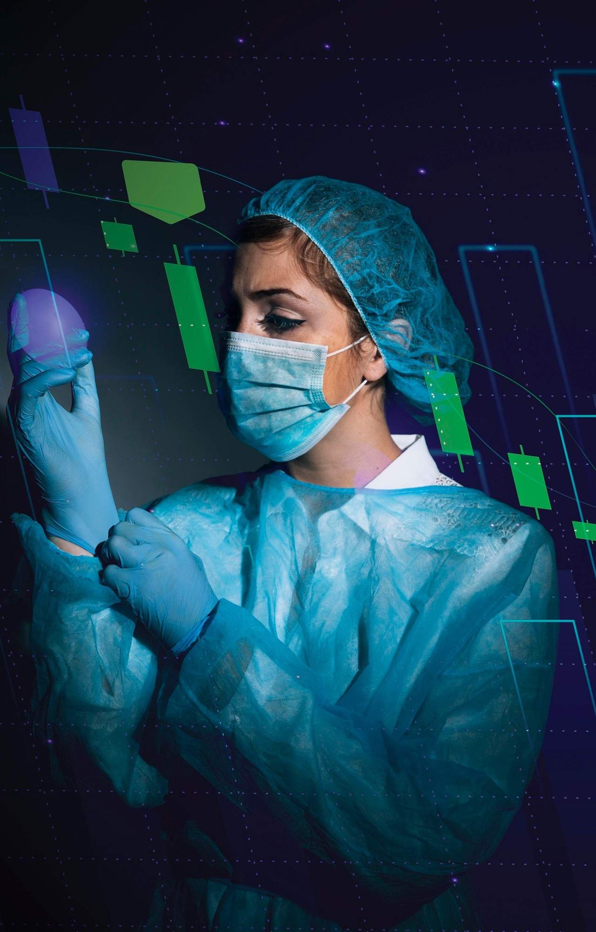
Advanced COVID-19 Detection from
Lung X-rays with Machine Learning or Deep Learnings
TEAM NO. : 1
BATCH : GCE_1

Slide 2
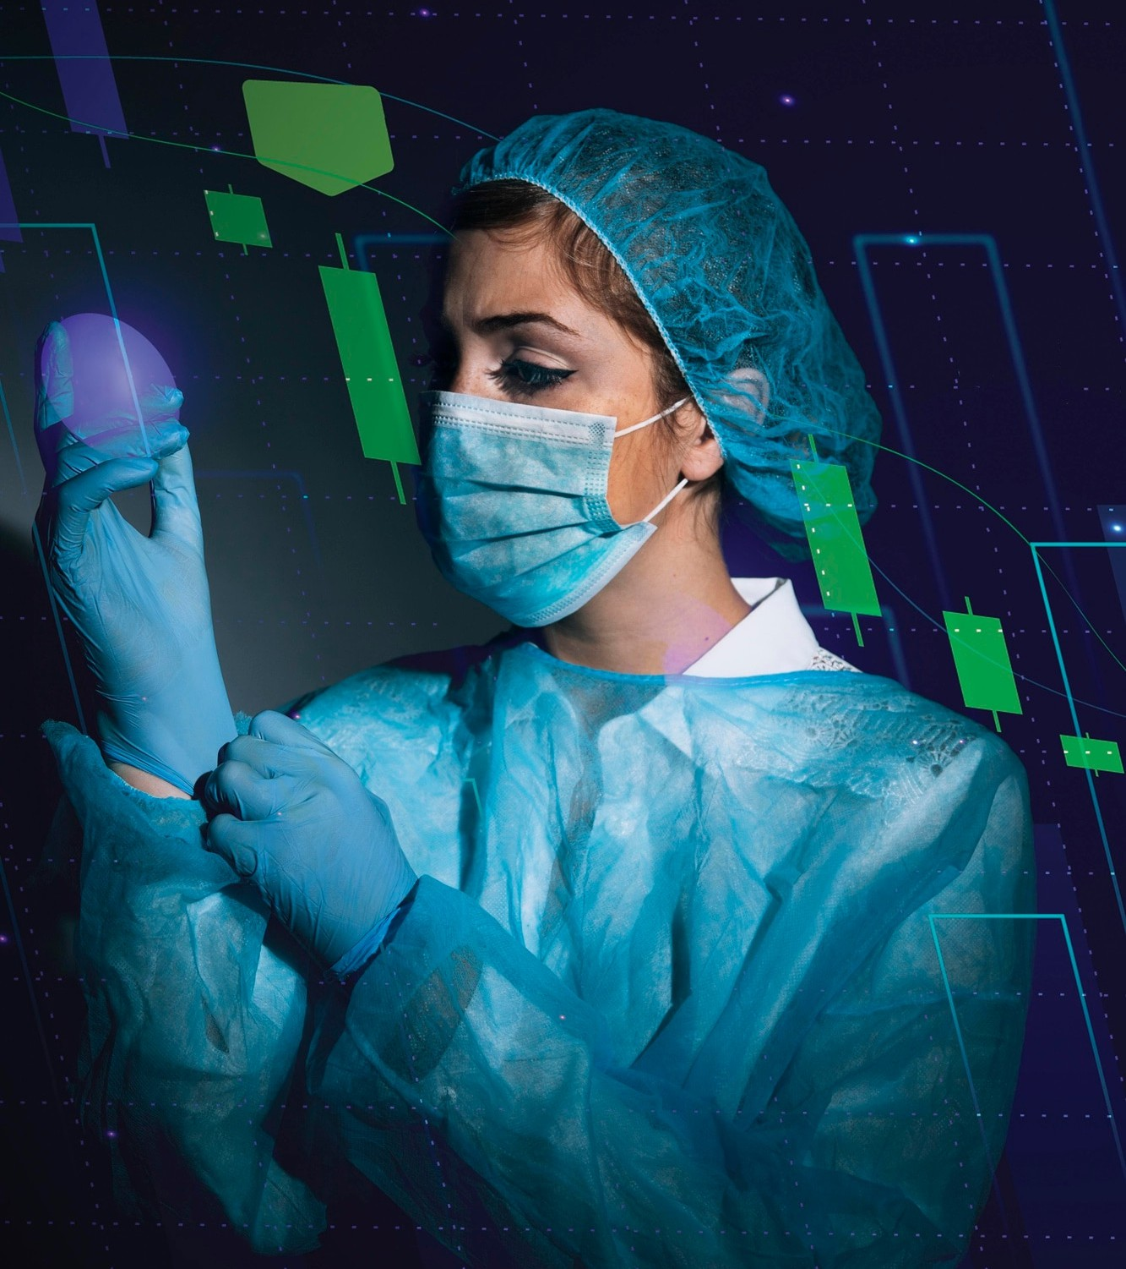
Introduction
The of using machine learning and X-ray scans. Exploring the potential of advanced technology to enhance early diagnosis and treatment. A game-changing approach to combating the global
pandemic.

Slide 3

Understanding Covid-19
An overview of the
and its impact on human health. Exploring the challenges of early detection and the potential risks associated with delayed diagnosis.

Slide 4
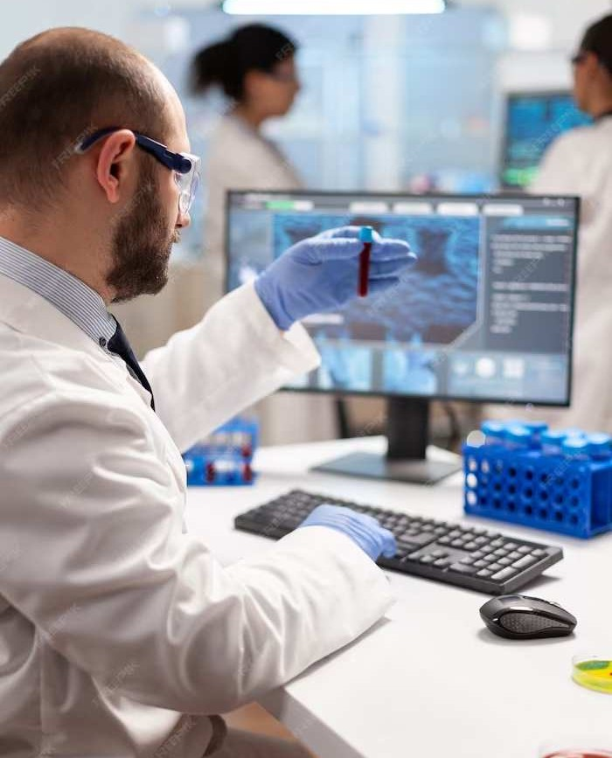
The Power of Machine Learning
Harnessing the potential of
in medical diagnostics.
Exploring how advanced algorithms can analyze complex data patterns to identify early signs of Covid-19 infection.

Slide 5
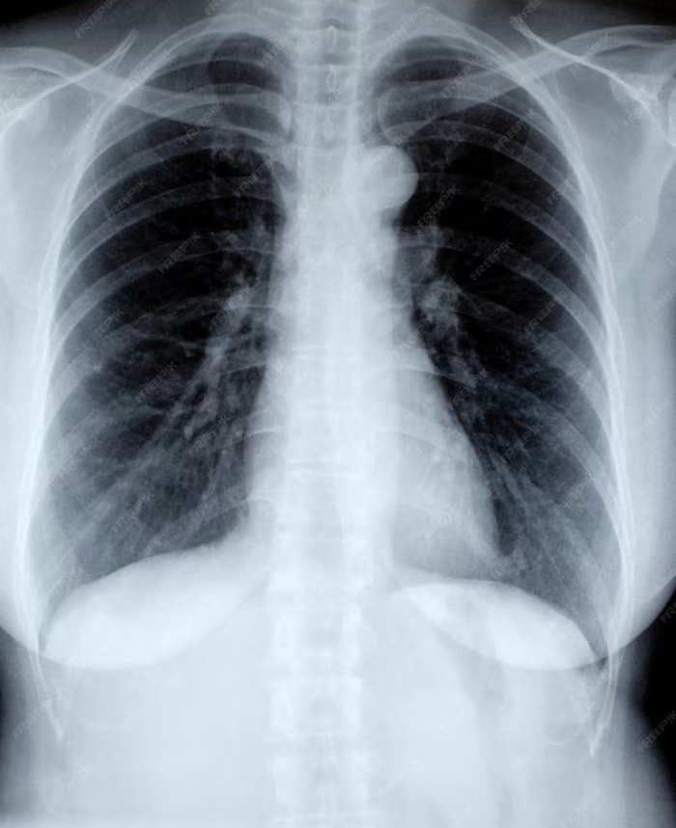
X-ray Scans in Covid Detection
Understanding the role of identifying lung abnormalities
in
associated with Covid-19. Exploring the potential of radiological imaging in early detection and monitoring of the disease.

Slide 6
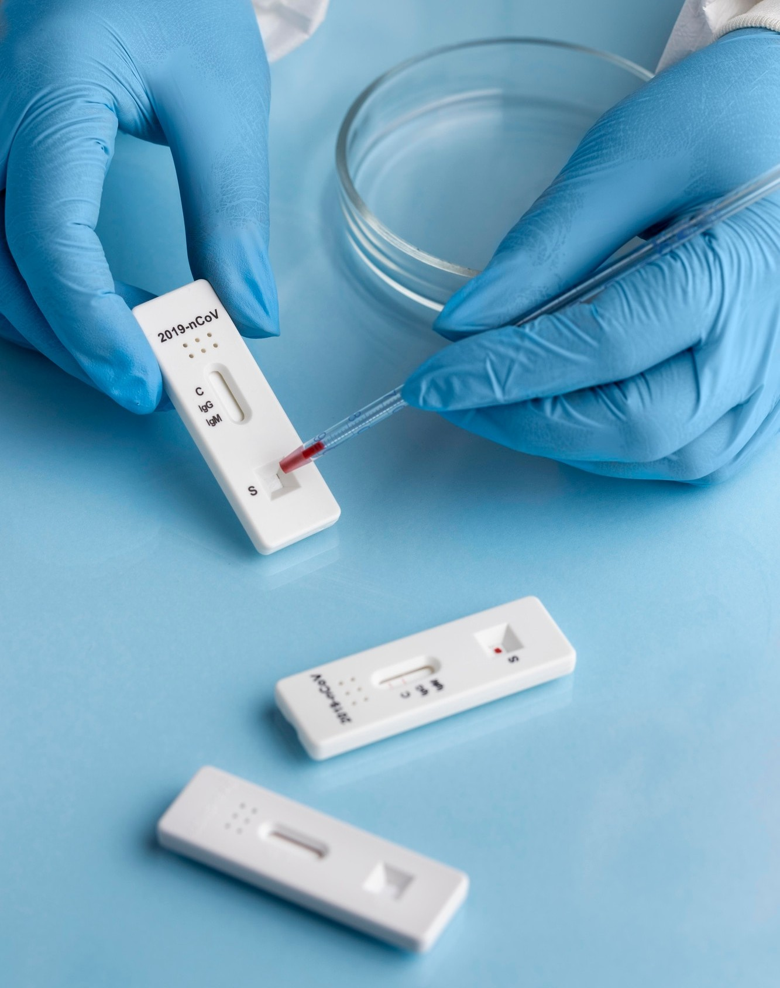
Challenges in Current Detection Methods
An analysis of the limitations of current Covid-19 detection methods. Highlighting the need for more accurate, efficient, and scalable diagnostic approaches to combat the pandemic.

Slide 7
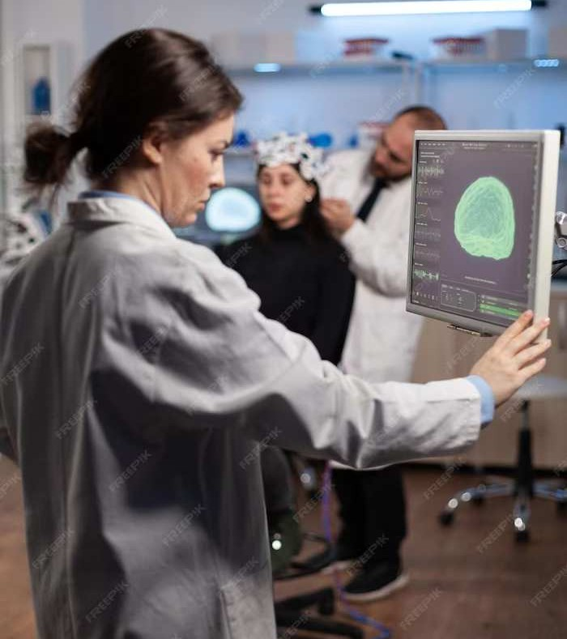
Advancements in Medical Imaging
Exploring the latest
in medical imaging.
Understanding how innovative imaging techniques can provide valuable insights for early Covid-19 detection and monitoring.

Slide 8
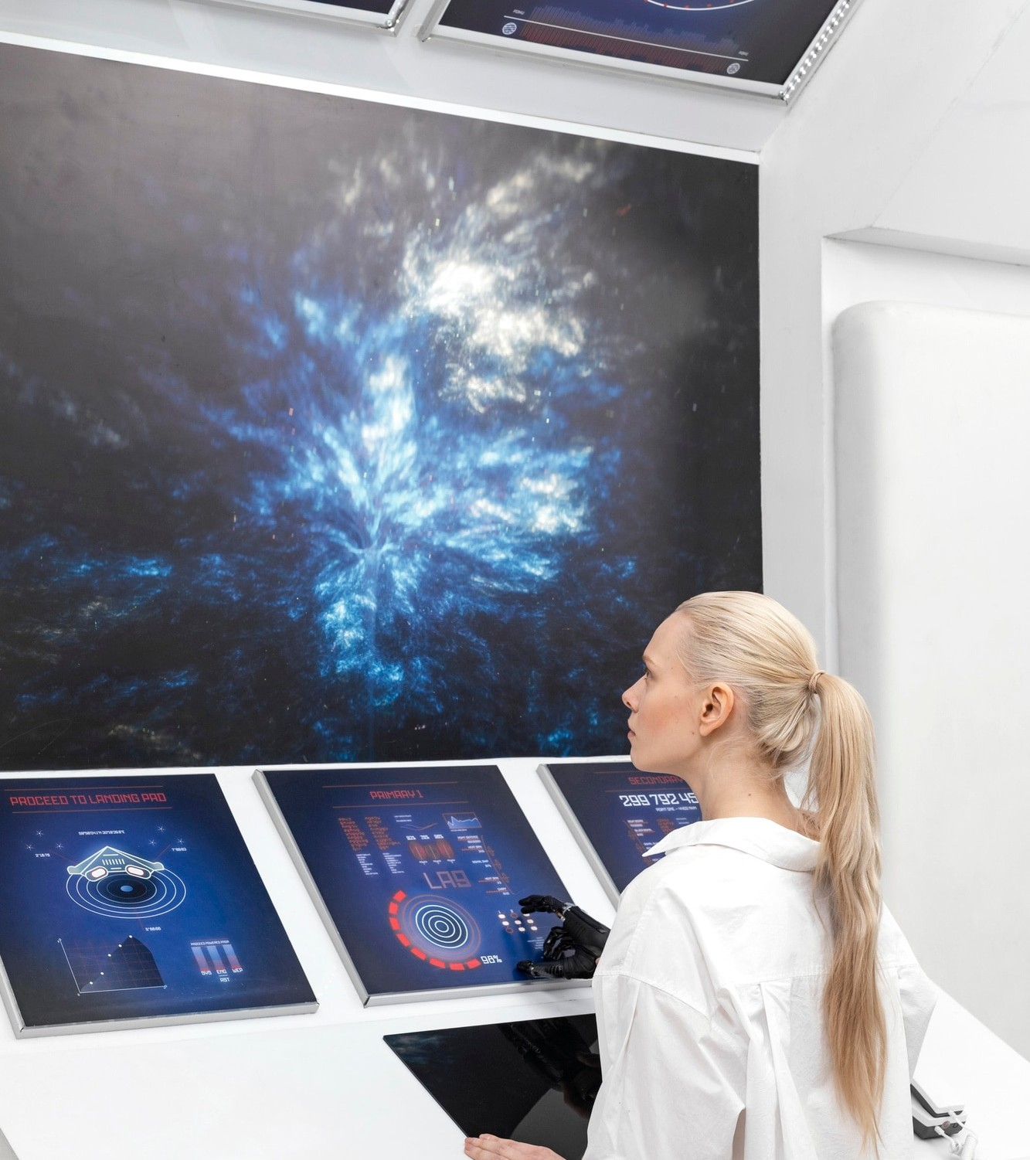
Integration of Machine Learning and X-ray Scans
The synergistic potential of integrating
with for
enhanced Covid-19 detection. Exploring
how these technologies can complement each other to improve diagnostic accuracy and efficiency.

Slide 9
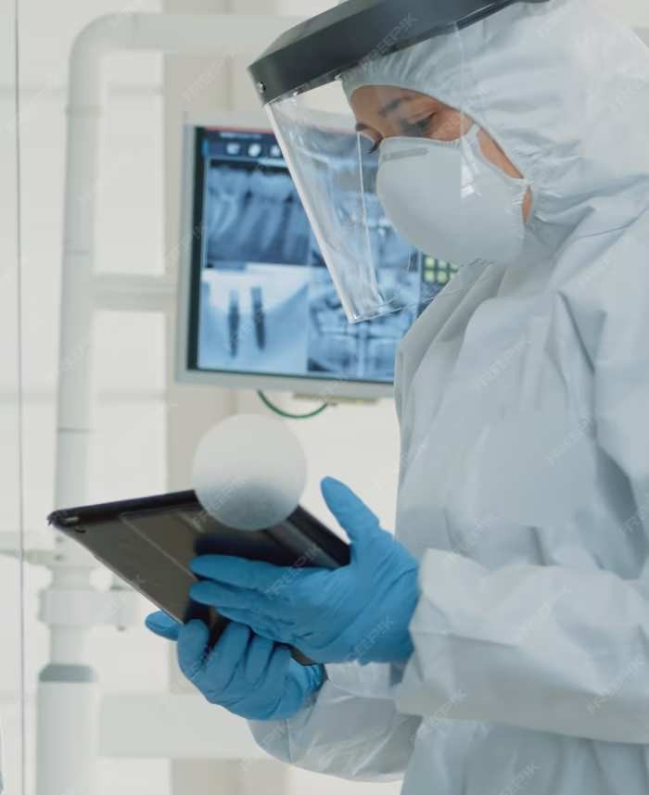
Data Analytics for Early Diagnosis
Utilizing to identify early patterns of Covid-19 infection. Exploring the potential of leveraging large-scale data to improve predictive models for early diagnosis and intervention.

Slide 10
Clinical Applications and
Impact
Understanding the potential
of machine learning and X-ray scans in Covid-19 detection.
Exploring the broader impact on public health and the potential for early intervention and treatment.

Slide 11
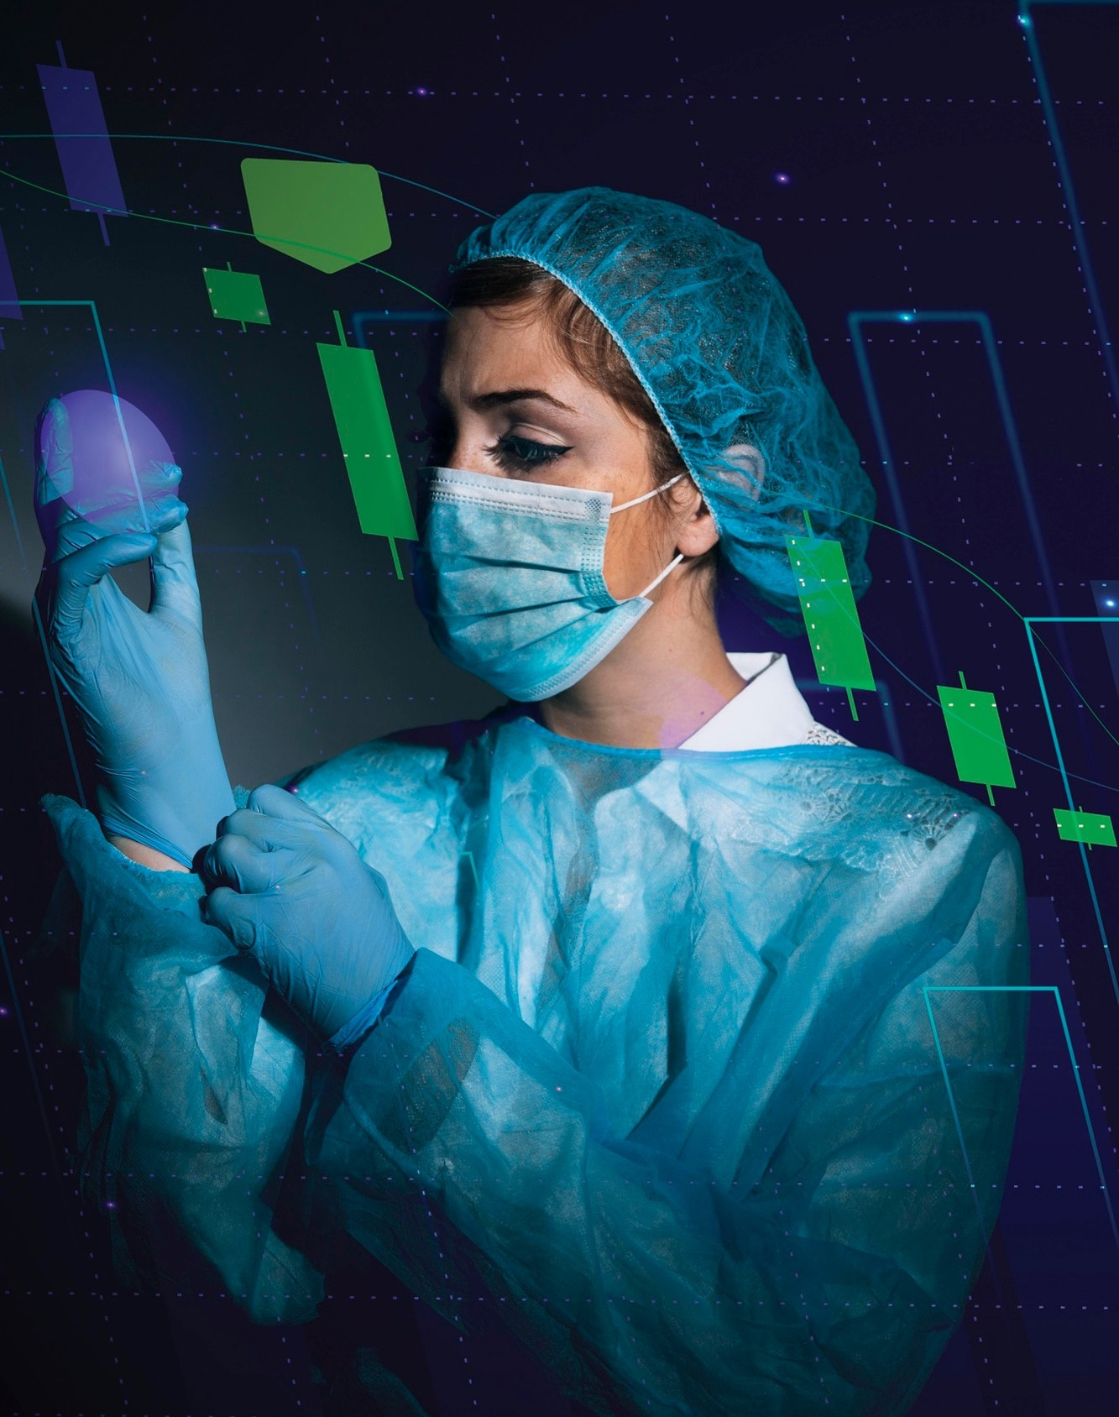
Future Prospects and Innovations
Exploring the future prospects of
in revolutionizing Covid-19 detection. Highlighting the potential for
continuous advancements and the role of research and development in shaping the future of medical diagnostics.

Slide 12
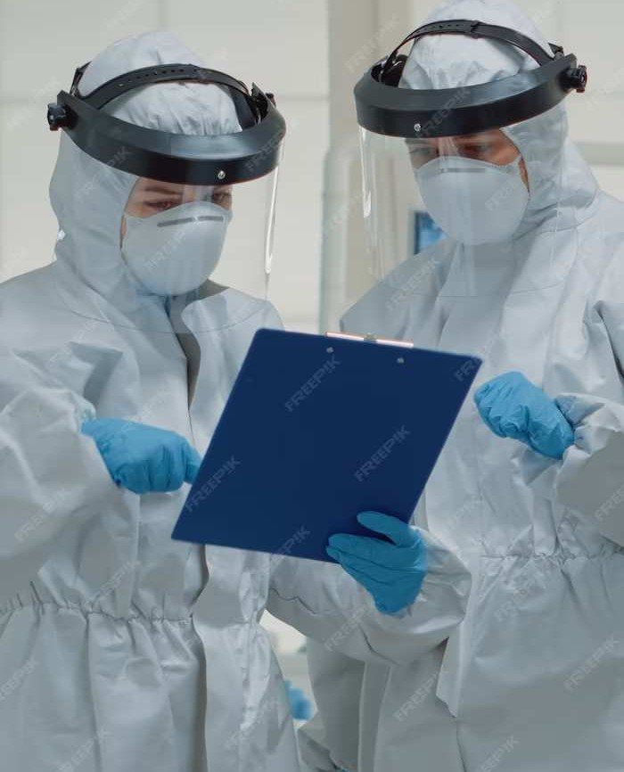

Ethical and Regulatory Considerations
Addressing the and associated with the
adoption of advanced diagnostic technologies. Exploring the importance of ethical guidelines and regulatory frameworks in ensuring safe and responsible deployment of these innovations.

Slide 13
Conclusion
Summarizing the transformative potential of
and in revolutionizing Covid-19 detection.
Emphasizing the need for collaborative efforts to harness the power of advanced technologies in combating the global pandemic.

Slide 14
THANK YOU
TEAM NO. : 1
BATCH : GCE_1
TEAM SIZE : 4
TEAM MEMBERS : MANOJ S
GURU PRAKASH G
GOWTHAM D
JENISH DEVA RAJ J

